Slide 1

Infrastructure as Code: ARM Templates with Bicep
Notes:
Original contributors to the hack content & these slides include:
Peter Laudati
Al Wolchesky
Gino Filicetti
Ali Hussain
Pete Rodriguez
Victor Viriya-ampanond
Chris Bellee
John Downs
William Salazar

Slide 2




Infrastructure as Code: ARM Templates with Bicep
Welcome & Intros
<Coach Name>
<Coach Name>
<Coach Title>
<Coach Title>
<Coach Name>
<Coach Name>
<Coach Title>
<Coach Title>
Notes:
Coaches/Presenters for THIS hack/lecture event should be listed on this slide.
Original contributors to the hack content & these slides include:
Peter Laudati
Al Wolchesky
Gino Filicetti
Ali Hussain
Pete Rodriguez
Victor Viriya-ampanond
Chris Bellee
John Downs
William Salazar

Slide 3
Challenge #0 Get your machines ready!
Install Windows Subsystem for Linux (Bash Shell)
Install the Azure CLI (in WSL if on Windows!)
Install PowerShell Cmdlets for Azure
Install Visual Studio Code
Install ARM Tools extension for VS Code
Install Bicep extension for VS Code
Notes:
If you have a Mac… great! You’re already a step ahead.
If not, get your Windows box loaded up with all the tools that work well in the OSS world!
You COULD use the Azure Cloud Shell to complete the challenges in this hack but, if you’re going to be an InfraAsCode developer, you’ll want all of the tools installed locally on your workstation!

Slide 4
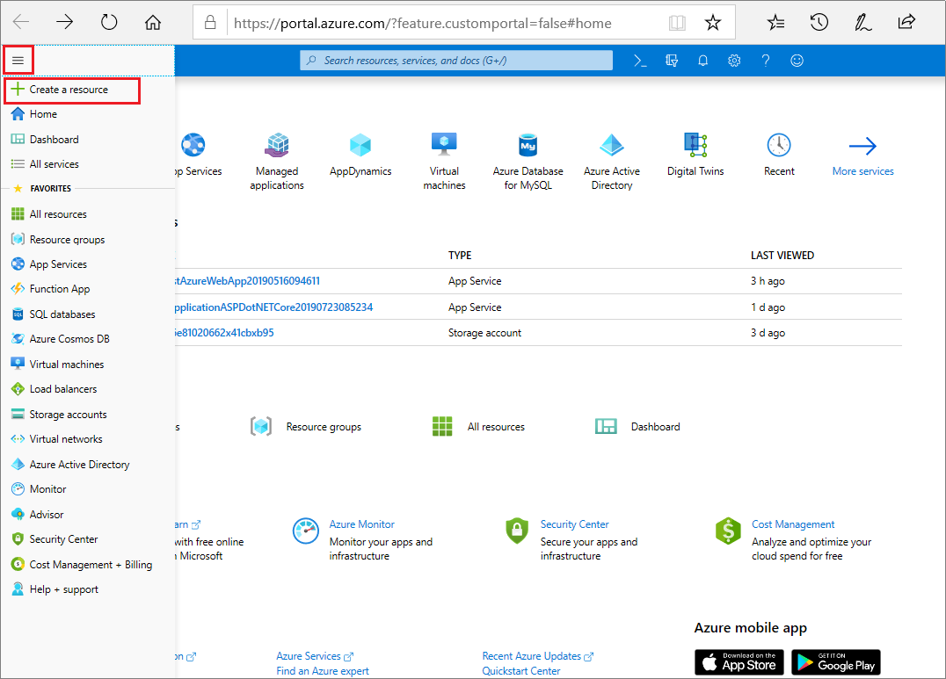
Notes:
Typically when people start working with Azure, they use the portal a lot
The portal is great, and it helps you get started quickly
But as you start to create more complex solutions, or need to have production and non-prod environments, you’ll start to find it a bit limiting to manually create and configure everything
In this part of today’s session I will talk about the many benefits of IaC, and why Victor and I and all of our team believe so strongly that it’s the best way to work with Azure, especially for customers who will be running at scale

Slide 5
What is Infrastructure as Code?

Slide 6
What is Infrastructure as Code?
A way of describing our infrastructure in a machine-usable format.
Notes:
This is the simplest definition.
It’s a little technical sounding IMO.
What it’s really means is to write CODE that will deploy and manage resources in the cloud in a repeatable manner.

Slide 7





What is Infrastructure as Code?
A way of describing our infrastructure in a machine-usable format.
‘Infrastructure’ doesn’t just mean IaaS.
PaaS and serverless resources
Networks and config
Access control policies
Databases and database objects
Azure resource config
Notes:
I want to be clear, “Infrastructure” as code doesn’t just mean “Infrastructure”
One common misunderstanding is that IaC is just for customers working with IaaS
In fact, IaC can be used across all of your resources:
PaaS and serverless resources, like App Service, Azure Functions, and Logic Apps
Networks, and network configuration like subnets, routing tables, peerings, and NSGs
Access control policies, specifying who can access which resources in your Azure environment
Databases, and database objects like tables, stored procedures, and views
And the configuration of any Azure resource

Slide 8
Why use Infrastructure as Code?
Notes:
Why should we use Infrastructure As Code?
There are a LOT of reasons! I won’t get into them all right now.
But the main one is…

Slide 9
Why use Infrastructure as Code?
It’s critical to succeeding in the cloud!
Notes:
It’s simple: You WON’T succeed managing a large scale cloud environment without a repeatable way of deploying & managing resources.
Infrastructure as Code is CRITICAL to succeeding in the cloud!
There is no way you manage 10s, 100s, or even 1000s of resources in the cloud by clicking your way through the Azure portal.

Slide 10

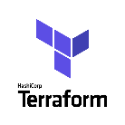



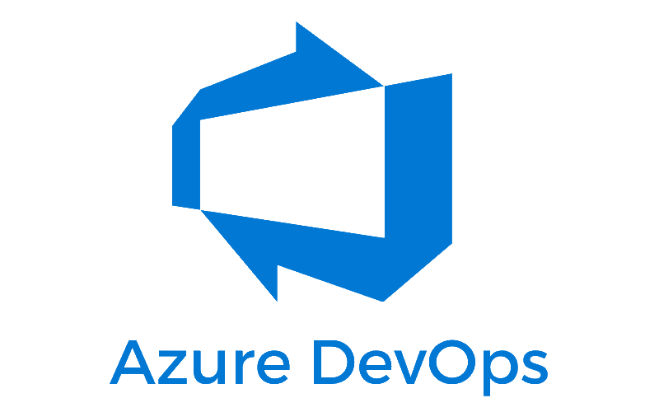


Infrastructure as Code Three major parts
Deploying infrastructure
All of the stuff outside the VM
Networking, VMs, storage, PaaS services, etc
Configuration Management
Configuring all of the stuff inside the VM
Security, services, software, etc.
Orchestration
Stringing it all together with automation
ARM Templates
PowerShell
DSC
Notes:
Implementing Infra as Code is one of the first steps you need to take to develop a devops process.
You need Infrastructure as Code to do devops.
There are three major components that make up Infrastructure As Code.
There are many tools out there that help with Infra as Code.
Here is the technology landscape.
Compare and contrast the different technologies and what areas they play a role in.
Deploying Infra => ARM/Terraform/Ansible
Config Management => PowerShell DSC/Chef/Puppet/Salt/Ansible/shell scripts
Orchestration => Jenkins/Spinnaker/AzureDevOps/Github

Slide 11
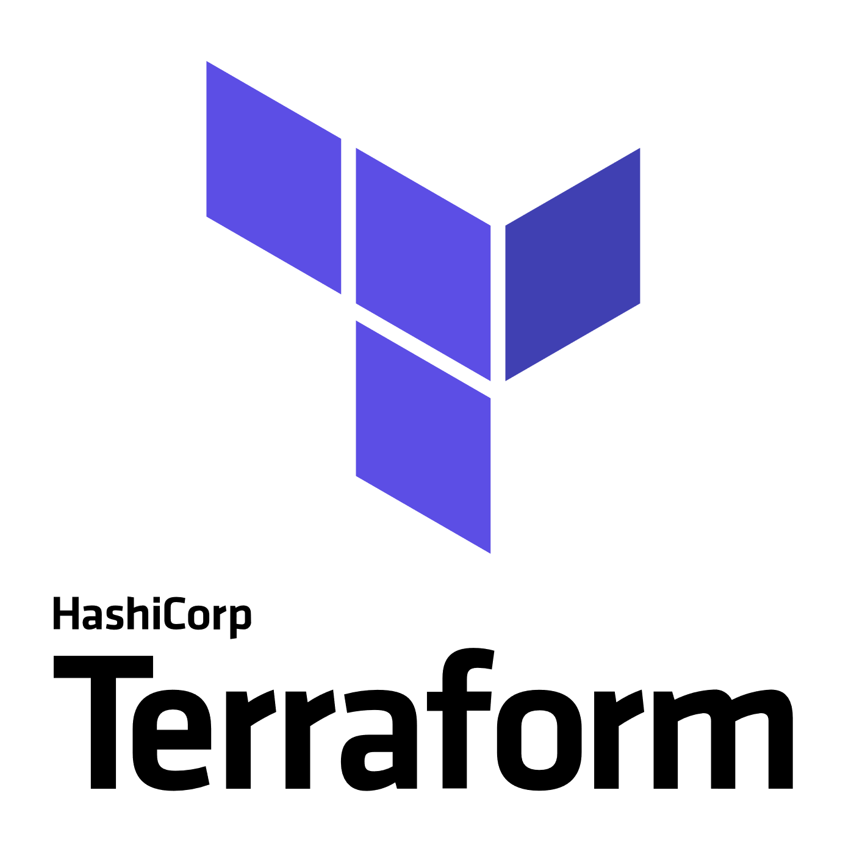
3rd Party
Infrastructure
Deployment (Orchestration)
Terraform
A popular Infrastructure as Code tool as it has support for Azure, AWS, GCP, OpenStack and bare metal, providing customers with a single provisioning language across providers
Provider modules allow for provider specific features, so no “lowest common denominator” flaws of similar multi-cloud tools
“Planning” provides users a preview of changes prior to execution (Terraform plan)
https://docs.microsoft.com/en-us/azure/virtual-machines/terraform-create-complete-vm
https://www.terraform.io/docs/providers/azurerm/
Packer
An automated image builder capable of building containers, but primarily used for automating VM image builds
A great tool when combined with DevOps pipelines that are targeting deployment to services like Azure VMs, VM Scale Sets or Batch
Used internally to deliver VM images for HD Insights and Azure Container Service
https://aka.ms/azpacker

Slide 12


3rd Party
Configuration Management & Orchestration
Ansible
Configuration Management & Orchestration
Agentless architecture over SSH / WinRM
Benefit of more easily integrating existing environments
YAML based “Playbooks” to define automation tasks as code
Project now run by Red Hat
https://docs.microsoft.com/en-us/azure/virtual-machines/linux/ansible-create-complete-vm
https://docs.ansible.com/ansible/guide_azure.html
Chef Server
Configuration Management
Integrates in to Chef’s Automate offering, available in Azure Marketplace
YAML/JSON based “Cookbooks” to define automation tasks as code
Agent based, requires an agent installed on managed servers.
https://www.chef.io/implementations/azure/
Notes:
Compare/Contrast: (Orchestration vs Configuration Management tools) Configuration management tools such as Chef and Ansible,typically default to a mutable infrastructure paradigm. For example, if you tell Chef to install a new version of OpenSSL, it’ll run the update on your existing servers and the changes will happen in-place. Over time, as you apply more and more updates, each server builds up a unique history of changes. This often can lead to configuration drift, where each server becomes slightly different than all the others, leading to subtle configuration bugs that are difficult to diagnose/reproduce. If you’re using an orchestration tool such as Terraform to deploy machine images created by Docker or Packer, then every “change” is actually a deployment of a new server, you would create a new image using Packer or Docker with the new version of OpenSSL already installed, deploy that image across a set of totally new servers, and then de-provision the old servers. This approach reduces the likelihood of configuration drift bugs. Of course, it’s possible to force configuration management tools to do immutable deployments too, but it’s not the idiomatic approach for those tools, whereas it’s a natural way to use orchestration tools.
Chef and Ansible encourage a procedural style where you write code that specifies, step-by-step, how to to achieve some desired end state. Terraform, CloudFormation, SaltStack, and Puppet all encourage a more declarative style where you write code that specifies your desired end state

Slide 13


OrchestrationTools
Jenkins
Most popular Continuous Integration & Continuous Delivery Tool
Especially popular with Java shops
An extensive community and catalog of plugins available
Azure Plugins available to use on-demand VMs for Build & Test
Jenkins Solution Template: https://aka.ms/jenkins-on-azure
Microsoft published. A Jenkins build secured for Azure and pre-configured with Azure plugins and tools
Jenkins Hub is a great starting point for customers: http://aka.ms/azjenkinshub
Spinnaker
Continuous Deployment Tool
Originally open sourced by NetFlix
Provides the ability to manage continuous deployment pipelines with multiple deployment strategies and the ability to roll back easily to previous versions
Spinnaker Code Labs for Azure:
CD to Azure VM ScaleSet
CD to K8s on Azure

Slide 14
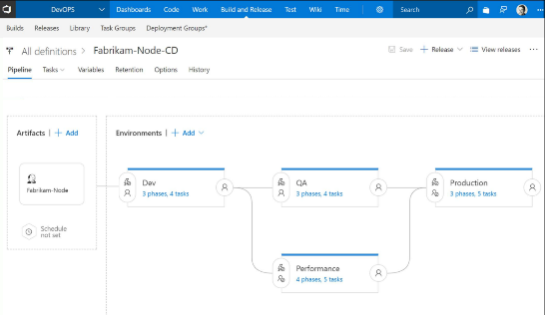
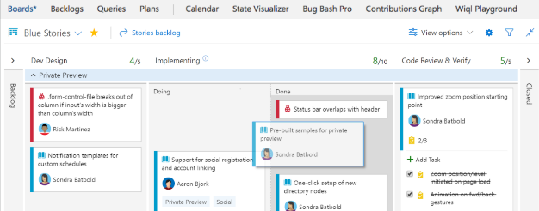
CI/CD Tools
Azure DevOps
Microsoft’s Continuous Integration & Continuous Delivery Tool
Test and deploy your code to production with high-performance pipelines. Start small and scale up as needed.
AzDO has everything you love about Git with free private repositories, pull requests, and code review.
Collaborate with coworkers then integrate with CI/CD to get your code to production fast.
AzDO gives you configurable Kanban boards, interactive backlogs, simple planning tools, and out-of-the-box support for Scrum-all integrated together for traceability and reporting.
Code once and share packages across your organization. Host your private Nuget, npm, and Maven packages with AzDO for more reliable, scalable builds.

Slide 15
Azure Resource Manager Overview

Slide 16



How Azure is Organized
Account and Enterprise Management
Management Groups
Subscription(s)
Resource group
Resource group
SQL
SQL
Role-based access control
Tags
Azure Resource Manager policy
Templates
Notes:
If you are an Enterprise Customer, Azure is organized as such:
Accounts & Enterprise Management
Management Groups
Subscriptions
Resource Groups
Resources
Presentation notes:
Key concepts:
Resource groups: application lifecycle boundary; container that holds resources.
Resources: web apps, Azure SQL Database, storage account, network, and so on…almost everything.
RBAC (role-based access control): User groups with role permissions assigned to resource groups.
Tags: Key value pairs assigned to resources or resource groups.
Policy: Restrictions on resources; for example, we can enforce mandatory tags per resource type.
Templates: JSON (JavaScript Object Notation) defining deployment and configuration of your application.
Slide objective:
Explain the hierarchy of the Azure model and key concepts.
Speaker notes:
When we talk about how we’ve done our Azure structure, we think about subscriptions. You want to lay out your subscriptions based on technology, the type of policy that you want to apply, and how your business is laid out. We use RBAC, which is role-based access control, to ensure that the right people have the right access to the right subscriptions. We want to make sure that people can operate their business, information remains protected, and people can’t make changes when they’re not supposed to.
The lower level is the concept of the resource group, an Azure construct that allows you to put the various resources associated with a single app into a resource group and then apply policy from Azure Resource Manager and tags. We use tags—key-value pairs—in Microsoft IT to identify the organization that it’s related to, the environment, and the app ID, a unique identifier. We can use these tags to associate different resources to a different app, organization, or environment, and then make business decisions based on that. Resources include web apps, Azure SQL Database, storage account, and so on.
Templates: We’ve created specific templates that internal teams can use to build out resources, and we ensure that they build them out according to our standards and policies. Templates enforce the creation of tags for tracking.

Slide 17
How Azure is Organized Resource Groups
Logical groups of multiple resources of similar or different types
Every resource must be in a resource group, cannot be in more than one
Resources inside resource group may span across regions
Resource Group has a location for storing metadata
RESOU
R
CE G
R
OUP

Slide 18
How Azure is Organized Resource Group Lifecycle
Question:
Should these resources be in the same group or a different one?
Hint:
Do they have common lifecycle and management?
Answer:
Up to you.

Slide 19
How Azure is Organized
Organizational concepts
Resource groups
Tightly coupled to a container of resources
Follows RBAC rules
1 resource group at a time
Tags
Loosely coupled user or system defined categorization
Arbitrary boundaries
15 tags to use as needed
Resource groups and tags are the building blocks from which users define applications.
Notes:
Resource Groups are a tightly coupled grouping of resources.
Resources MUST belong to a Resource Group. But an “application” may be composed of resources in multiple resource groups.
Tags can be used to LOOSELY couple resources together based on any definition you choose.
For example, you can use tags to define an “application”, or “department”, or a “cost center”.
Tags make it easier for you to track what resources correspond to.
Whether through monitoring or billing, tags can be used to filter/sort resources.

Slide 20
How Azure is Organized Access Control: RBAC
Allows secure access with granular permissions to resources
Access is assignable to users, groups, service principals, or VMs (system managed identities)
Built-in roles make it easy to get started
Notes:
RBAC is used to control WHO can do WHAT to Azure Resources.
WHAT: Granular permissions to Azure resources
WHO: Access assignable to users, groups, service principles (aka service accounts), or Azure resources themselves (aka system managed identities).
Example of a “system managed identity”:
It’s an identity created dynamically by the Azure for the lifetime of the resource that has no secrets.
The managed identity can be assigned permissions like any other identity!
For example, when creating an AKS cluster, the managed identity for the AKS cluster gives the cluster permission to control its own underlying resources.
AKS has permission to add/remove VMs to scale up/down or provision a Public IP address to expose a service to outside traffic!
Another example: A VM has a managed identity that allows the VM to check Azure APIs to know if/when a maintenance update (reboot) is scheduled.

Slide 21
How Azure Works
Resource Providers
Individual resources
Provision resources in isolation
Deployment becomes more complex
Management of app is challenging
Proper use of resources becomes more abstract
Isolation makes communication a challenge
Storage
Web Site
Virtual Machine
Database
Notes:
It starts at the fundamental layer of a “Resource Provider”
Azure is a collection of many services.
Many of these services are developed and maintained by different product teams within Microsoft.
When a new service is released, the product team develops a “Resource Provider” which provides the underlying APIs to manage and interact with the resources in that service.
For example Microsoft.Compute is a provider that supplies the virtual machine resource.
resource provider - A service that supplies the resources you can deploy and manage through Resource Manager. Each resource provider offers operations for working with the resources that are deployed.

Slide 22
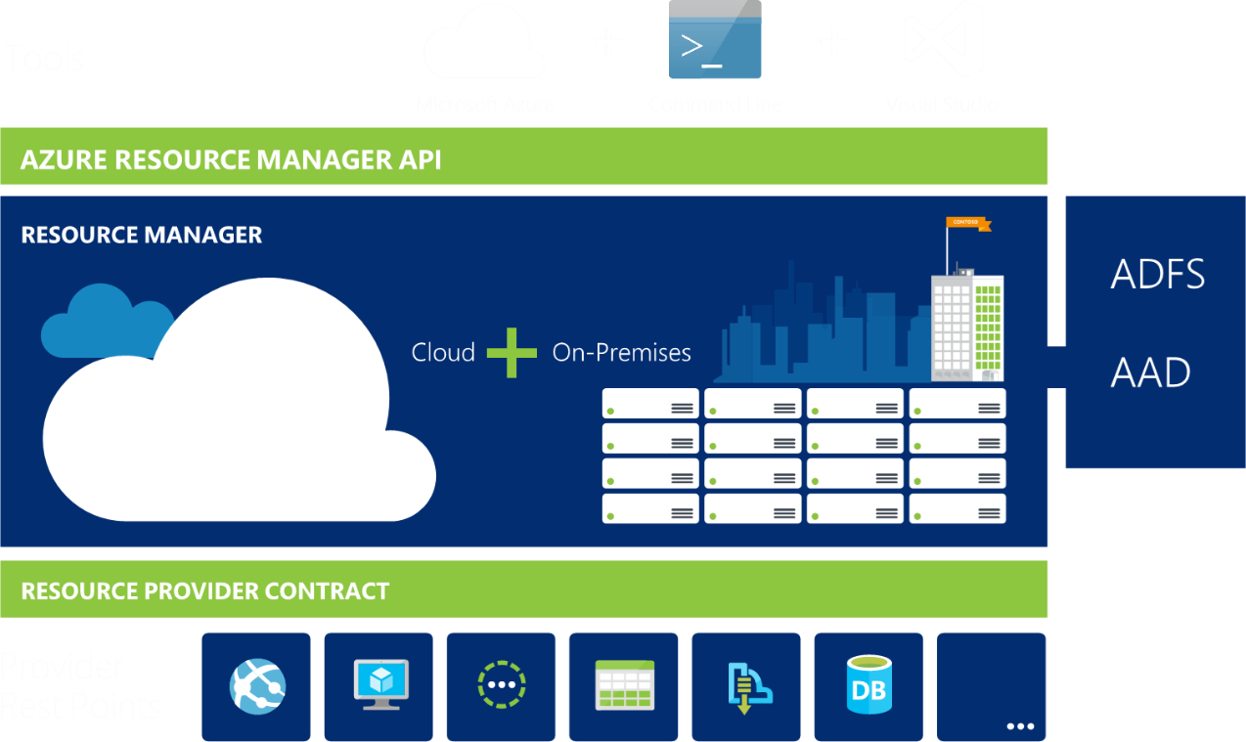
How Azure Works Azure Resource Manager
Azure Resource Manager or ARM management interface for Azure
Notes:
ARM is the underlying tooling that allows for the provisioning, securing and deployment of Azure Resources.
There is one Azure Resource Manager API that talks to the underlying Resource Providers to provision and manage resources in Azure.
The ARM API is integrated with Azure Active Directory to manage identity/security/access.
The ARM API is a REST API that can be accessed by any http client.
Definitions:
resource - A manageable item that is available through Azure (e.g. virtual machine, storage account, web app, database, virtual network etc)
resource group - A container that holds related resources for an Azure solution. The resource group can include all the resources for the solution, or only those resources that you want to manage as a group.
resource provider - A service that supplies the resources you can deploy and manage through Resource Manager. Each resource provider offers operations for working with the resources that are deployed. For example Microsoft.Compute is a provider that supplies the virtual machine resource.
Resource Manager template - A JavaScript Object Notation (JSON) file that defines one or more resources to deploy to a resource group. It also defines the dependencies between the deployed resources. The template can be used to deploy the resources consistently and repeatedly.
declarative syntax - Syntax that lets you state "Here is what I intend to create" without having to write the sequence of programming commands to create it. The Resource Manager template is an example of declarative syntax.

Slide 23
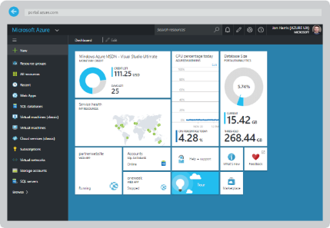
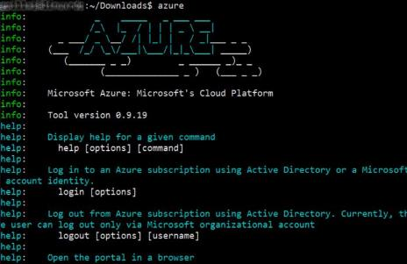
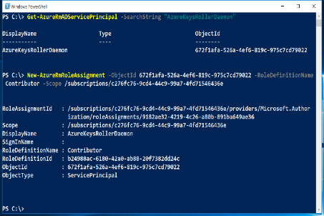
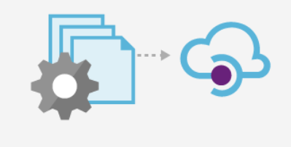
How Azure Works
All interfaces lead to the same API…
Azure Portal
Azure CLI
Azure PowerShell
ARM Templates
Azure Resource Manager API
Notes:
All of the ways we interact with Azure… the Portal, CLI, PowerShell, or ARM Templates
All interact with the underlying ARM API
Once a new Resource Provider is created/updated by the product team, the corresponding “front ends” need to be built for all of these.
When a service is in preview mode, it can vary which frontend is updated first.
Often, support for the CLI appears first, followed by Portal later.

Slide 24
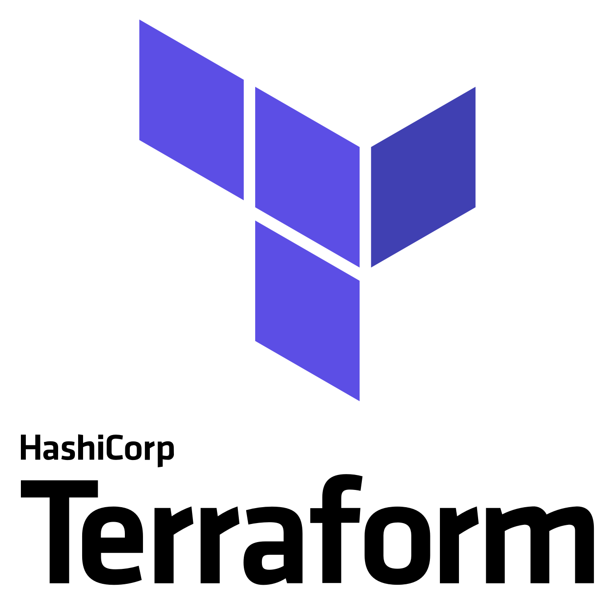
How Azure Works
All interfaces lead to the same API…
Azure Portal
Azure CLI
Azure PowerShell
ARM Templates
Azure Resource Manager API
Notes:
If we expand this picture out… you can see, the other Infra As Code tools interact with the same underlying Azure API.
One caveat of using ARM Templates versus Terraform or Ansible is that when a new service comes out, ARM templates will support it much quicker.
Support on Terraform or Ansible may lag until the service is out of preview mode.
It can lag longer depending on the popularity of the service and/or community support.
In my experience, it seems Terraform often gains support for new services faster than Ansible.
That’s not a knock on either of those technologies, it’s just the reality.
Conveniently, BOTH Terraform and Ansible have mechanisms to allow you to invoke an ARM Template for instances where direct support for an Azure Resource provider isn’t available.

Slide 25
(Re)Introducing ARM Templates with Bicep

Slide 26


Types of Infrastructure as Code
Imperative
Declarative
Notes:
Broadly speaking, there are two categories of IaC tools – imperative and declarative

Slide 27
Types of Infrastructure as Code
Imperative
Declarative
Issue commands.
You must handle:
Dependencies
Errors
Version upgrades
Idempotence
Describe the end state.
You tell the tool what you want.
It figures out how to do it.
Notes:
With imperative IaC, you issue a set of commands using a scripting language like Bash, PowerShell, or Python
You then have the responsibility to handle a number of different things.
If one resource depends on another, you need to make sure you handle the sequencing of the deployments.
If there’s an error when deploying or configuring a resource, you need to decide if you should continue or if it’s safe to stop.
Let’s say you are deploying version 3 of your infrastructure, and you have some environments on version 2 and some on version 1. You need to make sure your scripts know how to safely handle each combination. This gets harder and harder as you add more versions.
And, ideally, you need to make sure your script is idempotent – so you can run it over and over safely, without it interrupting your production solution or doing anything it shouldn’t.
Declarative IaC works differently. You describe the end state of what you want to achieve, and the tooling figures out how to make it happen. Even if you’re upgrading from lots of different versions, the tooling should be able to compare whatever is already there with whatever you want it to be, and apply the delta.
In a complex solution you will often end up having to use a mix of both, but personally I prefer to use declarative IaC as much as possible.

Slide 28
Types of Infrastructure as Code
Imperative
Declarative
Azure CLI or PowerShell
Sequential code calling commands to create the infrastructure.
ARM Templates
Either a Bicep domain-specific language (DSL) file or JavaScript Object Notation (JSON) file that defines one or more resources to deploy to a resource group.
A template also defines the dependencies between the deployed resources.
A template can be used to deploy the resources consistently and repeatedly.
Notes:
How does this translate in our world?
The Azure CLI or PowerShell are two tools for doing imperative Infra As Code.
ARM Templates are the declarative way of doing Infra As Code.
Terraform and Ansible also fall in this category. Although, Ansible blurs the lines a little bit.
Everyone is hear to learn about Bicep today. So far, you’ve seen me only discuss “ARM Templates”.
There’s a reason for this.
You can see how I’ve defined ARM Templates on this slide.
While Bicep is NEW, Bicep templates are STILL considered ARM Templates!
So let’s go talk more about Bicep and what it is (and what it is not)…

Slide 29
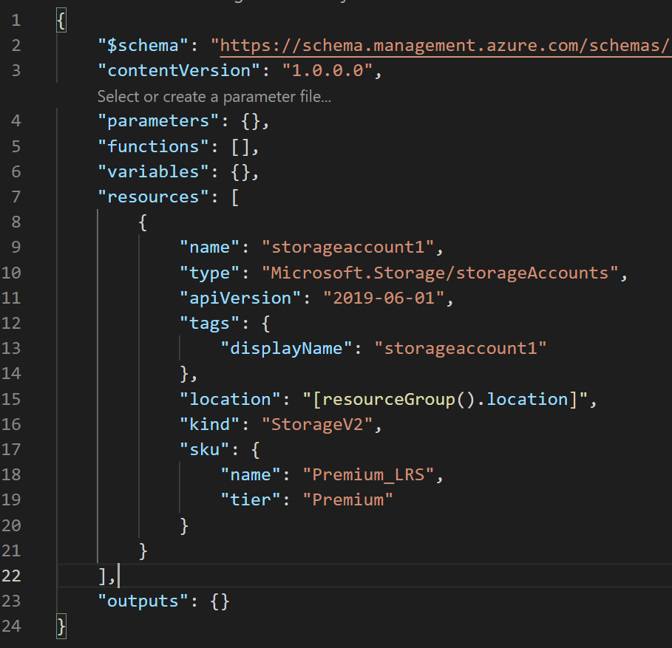
ARM Templates “1.0” A quick review
exampleTemplate.json
Declarative format defines resources to be deployed:
Parameters, Variables, Resources, Outputs
JSON files with lots of “{ }”s, “;”s, and name value pairs
Unforgiving error messages if you’re missing a semi-colon or a matching curly bracket
Use Azure CLI or PowerShell Cmdlets to deploy
Example ARM Template with JSON deployment via Azure CLI
terminal:~$ az deployment group create -f exampleTemplate.json –-resource-group exampleResourceGroup -n exampleDeployment
Notes:
When introducing Bicep, there are two groups of people:
Those who have been working with Infrastructure as Code and ARM Templates for a long time and want to learn what’s new in Bicep?
Those who are new to Infrastructure as Code and need to learn from scratch.
We’re going to try and thread the needle on both.
This means we’ll refer to what ARM Templates are and how they work, even if you don’t have much experience with them.
As we introduce Bicep and its concepts, we’ll point out how it relates to the ARM Templates you may already have experience with.
Let’s look at how ARM Templates with JSON have worked the past 10 years or so…
JSON files with well defined sections that are somewhat human readable. Walk through sections.
Point out the issues… JSON files are verbose.
Good luck if you miss a semi colon
Once you have this file, you can deploy it via the Azure CLI or PowerShell Here’s an example of what that looks like.

Slide 30
What is Bicep? For all the current ARM Template gurus
A new declarative domain-specific language (DSL) for deploying Azure resources
Bicep syntax reduces complexity and improves developer experience over JSON
Bicep files ARE considered ARM Templates!
Bicep is a “transpiled” language
During deployment, Bicep files are “transpiled” (or converted) into ARM Templates with JSON as an intermediate language (IL)
Bicep also has its own new icon

Slide 31
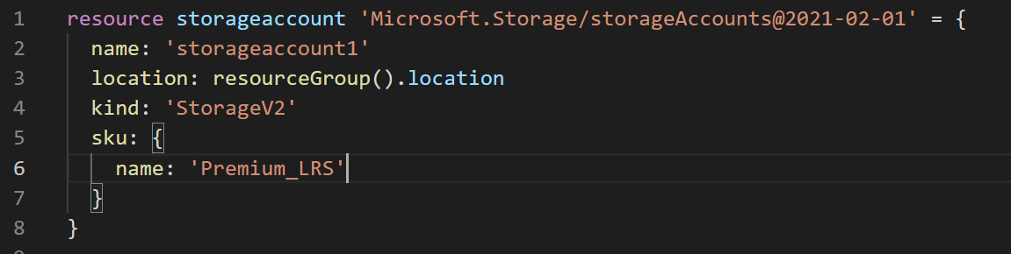
How Bicep Works For Everyone
exampleTemplate.bicep
Bicep template implements same storage resource from the previous JSON example
Use Azure CLI or PowerShell to deploy
Uses 8 lines of code instead of 24!
Look at all this empty space! ☺
Example ARM Template with Bicep deployment via Azure CLI
terminal:~$ az deployment group create -f exampleTemplate.bicep –-resource-group exampleResourceGroup -n exampleDeployment
Notes:
When introducing Bicep, there are two groups of people:
Those who have been working with Infrastructure as Code and ARM Templates for a long time and want to learn what’s new in Bicep?
Those who are new to Infrastructure as Code and need to learn from scratch.
We’re going to try and thread the needle on both.
This means we’ll refer to what ARM Templates are and how they work, even if you don’t have much experience with them.
As we introduce Bicep and its concepts, we’ll point out how it relates to the ARM Templates you may already have experience with.
Let’s look at how ARM Templates with JSON have worked the past 10 years or so…
JSON files with well defined sections that are somewhat human readable. Walk through sections.
Point out the issues… JSON files are verbose.
Good luck if you miss a semi colon
Once you have this file, you can deploy it via the Azure CLI or PowerShell Here’s an example of what that looks like.

Slide 32
How Bicep Works Under the covers
exampleTempate.bicep
Compile ARM Bicep Language
az bicep build –f exampleTemplate.bicep
exampleTemplate.json
Deploy ARM JSON Language
az deployment group create –f exampleTemplate.json…
Azure Resource Manager
Storage
IaaS
PaaS
Data
More!
Notes:
Credit for slide diagram: https://build5nines.com

Slide 33
Why Bicep? As opposed to ARM Templates with JSON or other IaC tools
Support for all resource types and API versions
Simple syntax
Authoring experience
Modularity
Integration with Azure Services
No state or state files to manage
No cost and open source
It’s ARM Templates “2.0”, come on board!
Notes:
Support for all resource types and API versions: Bicep immediately supports all preview and GA versions for Azure services. As soon as a resource provider introduces new resources types and API versions, you can use them in your Bicep file. You don't have to wait for tools to be updated before using the new services.
Simple syntax: When compared to the equivalent JSON template, Bicep files are more concise and easier to read. Bicep requires no previous knowledge of programming languages. Bicep syntax is declarative and specifies which resources and resource properties you want to deploy.
Authoring experience: When you use VS Code to create your Bicep files, you get a first-class authoring experience. The editor provides rich type-safety, intellisense, and syntax validation.
Modularity: You can break your Bicep code into manageable parts by using modules. The module deploys a set of related resources. Modules enable you to reuse code and simplify development. Add the module to a Bicep file anytime you need to deploy those resources.
Integration with Azure services: Bicep is integrated with Azure services such as Azure Policy, template specs, and Blueprints.
No state or state files to manage: All state is stored in Azure. Users can collaborate and have confidence their updates are handled as expected. Use the what-if operation to preview changes before deploying your template.
No cost and open source: Bicep is completely free. You don't have to pay for premium capabilities. It's also supported by Microsoft support.

Slide 34
ARM Templates & Bicep I say “po-TAY-to”, you say “po-TAH-to”
You can think of these as the following:
JSON == ARM Templates “1.0” or “Classic”
Bicep == ARM Templates “2.0”
Formally:
“ARM Templates with Bicep”
“ARM Templates with JSON”
You will also hear (or read):
ARM JSON or ARM Bicep
JSON ARM Template or Bicep ARM Template
JSON templates or Bicep templates
JSON files or Bicep files
ARM or Bicep
And probably other permutations that are bound to be confusing!
Notes:
Peter’s take on what to call these things now:
Bicep is new. The terminology is… less than consistent at the current time.
As long as you understand what the relationship is between Bicep and JSON, then the other permutations you hear should make sense.

Slide 35
ARM Template with JSON Revisited
Structure and elements
{
"$schema": "http://schema.management.azure.com/schemas/2015-01-01/deploymentTemplate.json#",
"contentVersion": "",
"parameters": { },
"variables": { },
"resources": [ ],
"outputs": { }
}
Declarative syntax
Allows you to declare the resources you want to have without having to write the script sequence of commands required to create it.

Slide 36
Let’s get a look at a Bicep template…

Slide 37
Bicep Template Parameters
Minimize parameters
Too many parameters may confuse the user
Use the “description” decorator to describe the parameter
This can help the user identify how and where the value will be used
Define default values
Setting default values guides user and reduces chances of invalid values
Parameters are mandatory, use default value to “make it optional”
Use securestring type
Passwords and secrets should use the securestring type

Slide 38
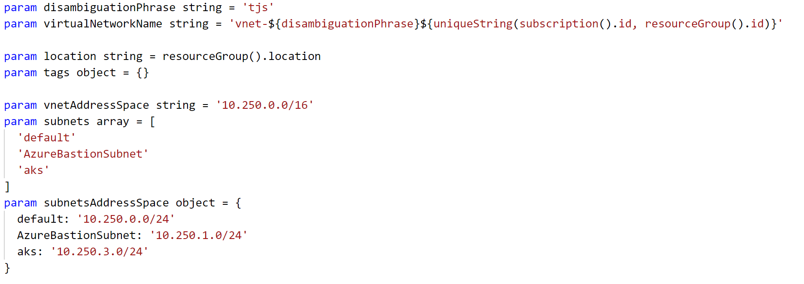
Bicep Template Parameters - Examples

Slide 39
Bicep Template Variables
Easier to read and edit
It can simplify your template, making it easier to read
Complex objects
Group variables into an object helps understand the template design
Custom values
Use expressions and functions to modify parameter values and construct new values

Slide 40
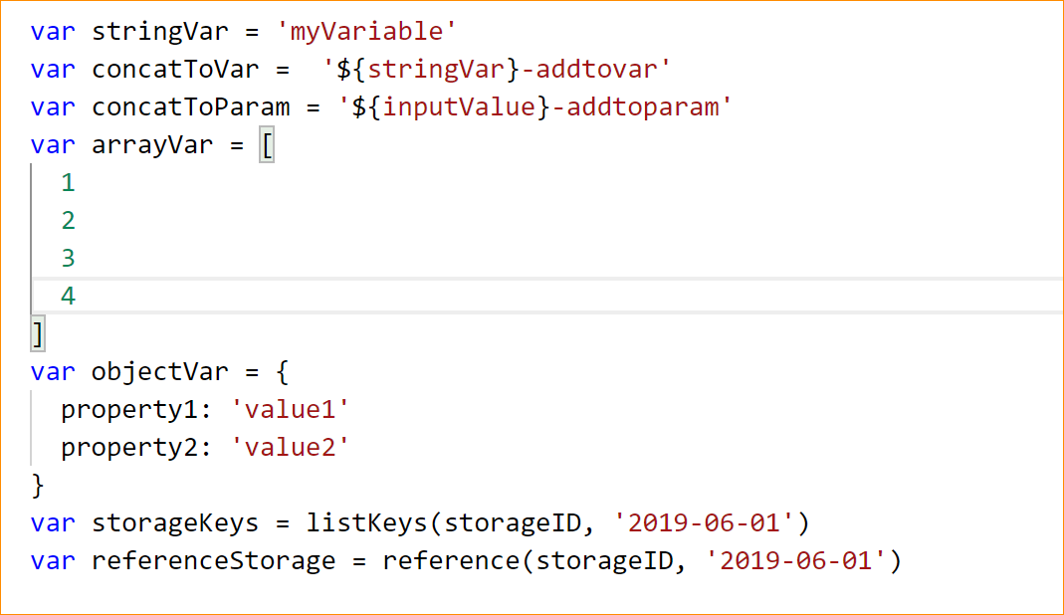
Bicep Template Variables - Examples

Slide 41
Bicep Template Resources
Use “//comments”
Bicep allows comments to help others understand the purpose of the resource
ApiVersion
This property value will define the structure of the “properties” section of the resource
Hard-code it on the resource, so Visual Studio Intellisense can recognize it
Protected Settings
Use this property to pass secrets if the resource type supports it

Slide 42
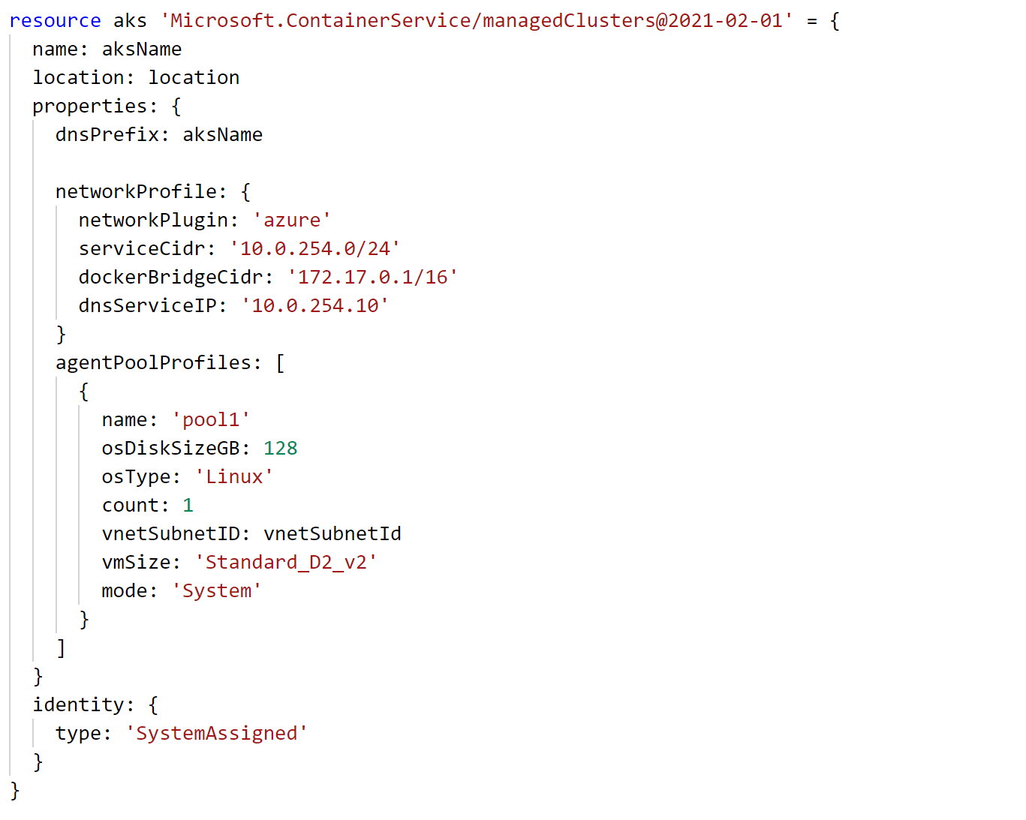
Bicep Template Resources - Examples

Slide 43
Bicep Template Deployment Revisited
PowerShell
PS C:\> New-AzResourceGroupDeployment -TemplateFile exampleTemplate.bicep -Name ExampleDeployment -ResourceGroupName ExampleResourceGroup
Azure CLI
terminal:~$ az deployment group create -f exampleTemplate.bicep –-resource-group exampleResourceGroup -n exampleDeployment

Slide 44
Challenge #1 Create a “Hello World” Bicep template
Create a template that:
Deploys an Azure Storage Account
Takes inputs:
Location
A unique storage account name
Returns output:
storage account ID
Deploy it from Azure CLI
Deploy it from PowerShell

Slide 45
Template Development with Bicep

Slide 46
ARM Templates Recap
Create a blank template with your favorite text editor
Complete walk-through : https://docs.microsoft.com/en-us/azure/azure-resource-manager/resource-group-authoring-templates
{
"$schema": "http://schema.management.azure.com/schemas/2015-01-01/deploymentTemplate.json#",
"contentVersion": "",
"parameters": { },
"variables": { },
"resources": [ ],
"outputs": { }
}
Strip away the details and the template core is seen above

Slide 47
Template Development Bicep Commands
az bicep build
az bicep decompile
az deployment group what-if
template.bicep
template.json
template.json
template.bicep*
Report on what changes will be made if this template is applied to current environment in Azure.
template.bicep
Notes:
VS Code Bicep & ARM tools extensions
Bicep build/decompile/what-if commands
Resource Explorer: https://resources.azure.com

Slide 48
Template Development Debugging
VS Code Editor & ARM/Bicep Extensions
Resource Explorer
Deployment output
Resource Group Deployments
Activity Logs
VM Extension Logs
Notes:
VS Code Bicep & ARM tools extensions
Bicep build/decompile/what-if commands
Resource Explorer: https://resources.azure.com
Deployment Output – view outputs from your template
Resource Group Deployments – In the portal, view log and records of deployments
Activity Logs – Browse logs in Azure portal to find out who/what/when a template was deployed
VM Extension Logs – This comes into play later when we start invoking scripts ON a VM (aka configuration management)

Slide 49
Template Development Parameters - Revisited

Slide 50
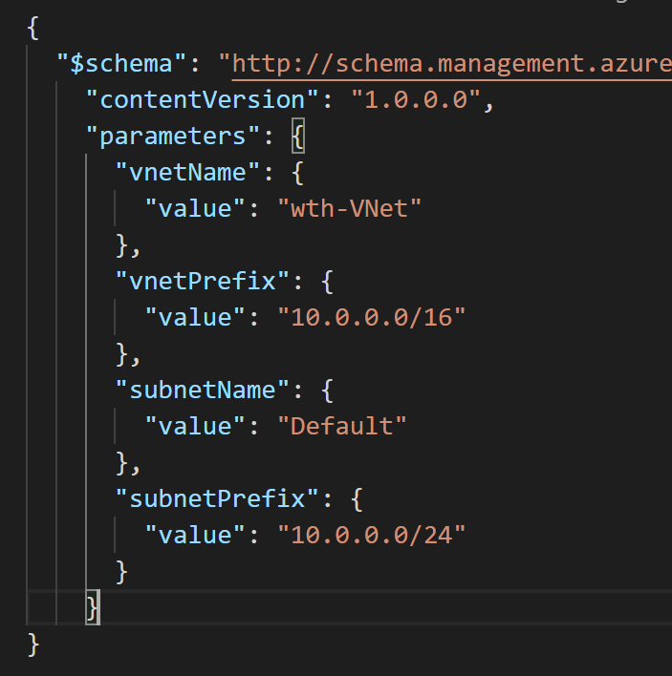
Template Development Parameter Files
exampleParametersFile.json
Pass multiple values into a template at deployment time
Use different parameter files with the same template to support deployment to different environments (e.g. “dev/test”, “qa”, “production”)
Bicep uses the same JSON-formatted parameters file as ARM Templates with JSON

Slide 51
Template Development How to find template samples…
Visual Studio code
Bicep & ARM Tools extension can inject template syntax for various Azure resources
Go to the docs! https://docs.microsoft.com/en-us/azure/templates
Export JSON Template from portal before resource creation
Template will be parameterized for single resource. Exports JSON only, need to decompile to Bicep.
Quickstart templates
JSON: https://github.com/Azure/azure-quickstart-templates
Bicep: https://github.com/Azure/bicep/tree/main/docs/examples
Export JSON Template from portal of existing Resource Group
To duplicate or slightly modify an existing template

Slide 52
Challenge #2 Expressions, Referencing resources, Parameter files
Modify template to provide unique storage account name
Add a prefix to resource names
Tidy templates are easier to read
Create a container in the storage account
Find an easier way to pass in parameters

Slide 53
Coach Warning!
The remainder of this Lecture presentation is from the original ARM Template (JSON) hack (WTH 011-InfraAsCode-ARM-DSC).
The lectures will be updated to match the Bicep hack, but we wanted to publish this work in progress so folks can deliver the hack.
Lectures are “optional”, so you can deliver the hack without them. The most important Bicep concepts are covered before Challenges 1 & 2.
Future lecture updates will cover:
Bicep Modules
Resource ID concept
Azure Key Vault
Custom Script Extension

Slide 54
Challenge #2 (OLD ARM) Deploy a simple network stack
Extend template to provision VNET w/one subnet
Template takes the following inputs:
Virtual Network Name and Address Prefix
Subnet Name and Address Prefix
Find an easier way to pass in parameters

Slide 55
ARM Template Functions
resourceGroup().location
concat()
resourceId()
Many more to explore later…

Slide 56
ARM Template Function: resourceGroup()

Slide 57
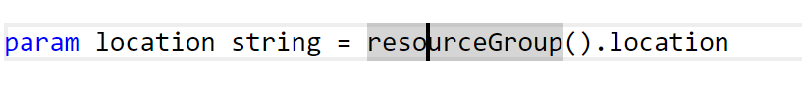
Snippet: resourceGroup() in action
All resources must be deployed to a location
Function provides the location of the resource group
Resources in a resource group can span multiple locations
E.g. A primary DB server located in “eastus” (same as the resource group), and secondary DB server located in “westus”

Slide 58
ARM Template Function: concat()

Slide 59
concat()…array and object function
Combines multiple arrays and returns the concatenated array, or combines multiple string values and returns the concatenated string
Concatenating multiple strings to create unique and dynamic names (in my opinion) is the most common and useful
“variables”: {
“vnetName”: “[concat(parameters(‘prefix’),’-VNET’)]”
…
}
https://docs.microsoft.com/en-us/azure/azure-resource-manager/resource-group-template-functions-array#concat

Slide 60
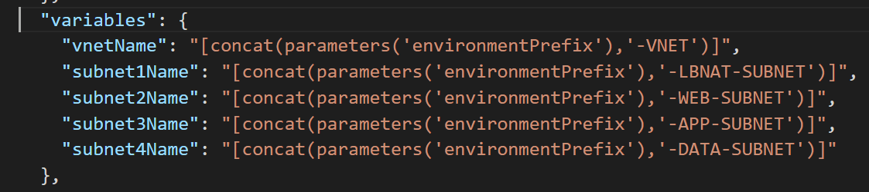
Snippet: concat() in action

Slide 61
ARM Template Function: resourceId()

Slide 62
ResourceID property
Unique identifier of a resource in Azure
Used to reference one resource as a parameter in another resource.
Example: A virtual machine needs to specify the resourceID of the NIC that it is attached to
Example: A NIC needs to specify the resourceID of the vnet+subnet that it is attached to. (Often, the Vnet will be deployed in a separate resource group!)
Example: A Vnet can specify the resourceID of a NSG that is applied to it.
A fully qualified ResourceID is a concatenation of:
<subscriptionID>/<resourceGroupName>/<resourceType>/<resourceName>
Example: “acc9711d-c67e-47b0-bba3-9f6561a68511/myResourceGroup/Microsoft.Network/networkSecurityGroups/myNSG”
ResourceID can be inferred from name & type if it’s unique within scope
Example: “<resourceType>/<resourceName>”
“Microsoft.Network/networkSecurityGroups/myNSG”
This works as long as there’s a NSG called “myNSG” in the current resource group.
If I’m looking for “myNSG” in some other resource group or subscription, then this won’t work!

Slide 63
resourceId()… The Resource Function
resourceId() is seen often in auto generated templates and some from the Git repo
Returns the unique identifier of a resource which is useful when the resource name is ambiguous or not provisioned with the same template
Often used to reference storage accounts or virtual networks in an alternate resource group
https://docs.microsoft.com/en-us/azure/azure-resource-manager/resource-group-template-functions-resource

Slide 64
Challenge #3 Deploy more than one resource
Extend template to open ports 80 and 22 on the default subnet
Hint: Consider variables, dependencies, resourceIds, and idempotency

Slide 65
Handling Secrets with Azure Key Vault AKA: Don’t Get Fired!
Do NOT store secret values in plain text JSON templates or parameter files
Seriously, this could cost you your job!
DO store secret values in Azure Key Vault
ARM templates provide an easy syntax for retrieving secret values from Azure Key Vault

Slide 66
Challenge #4 Let’s stay employed…
Create an Azure Key Vault and store a secret value in it
We have provided both Azure CLI & PowerShell Cmdlet scripts that do this for you.
You can find the scripts in the Resources folder for ARM-Challenge-04
create-key-vault-CLI.sh - Azure CLI
create-key-vault-PS.ps1 - PowerShell
Retrieve the secret value from Azure Key Vault and pass it into your template as a parameter without having the value exposed as plain text at any point in time!

Slide 67
ARM Template More Functions…
String
toLower()
uniqueString(context), talks about context of uniqueness (resourceGroup, Subscription, etc)
https://docs.microsoft.com/en-us/azure/azure-resource-manager/resource-group-template-functions-array

Slide 68
ARM Template Function: toLower()

Slide 69
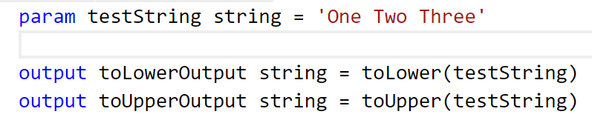
toLower()…string function
Useful collection string manipulation functions
How useful depends on your needs and approach to ARM templates
toLower() useful to help ensure proper formatting
Bicep functions - string - Azure Resource Manager | Microsoft Docs

Slide 70
Error without toLower()
Run nb-tolower-deploy.json with and without toLower (example error message without toLower below)
"error": {
"code": "AccountNameInvalid",
"message": "storev22NBTL062017 is not a valid storage account name. Storage account name must be between 3 and 24 characters in length and use numbers and lower-case letters only."
}

Slide 71
Advanced Functions: Food for thought
Some functions are easy to integrate into your templates (concat)
Some functions require some trial-and-error to get them to do what you expect (copyIndex)
Obviously, some functions are more useful than others and some are simply not worth the effort
The real question is…how much intelligence do you want to insert into your templates?
It might make more sense to use Powershell or CLI as the “glue” that holds the template(s) together and contains the “real” intelligence
The bigger the template, the harder to maintain

Slide 72
Practices to avoid. . . ( !best practices )
Starting from scratch. . .
Leverage QuickStarts, Automation Script / Export, etc. to quickly get started
Over-parameterization (no defaultValues)
Use variables, functions/expressions, & intelligent defaults!
Duplicating code
Copy/Pasting and Nesting instead of using copy loops & functions/expressions
Variables for the sake of variables
“vmName” : “[parameters(‘vmName’)]”
Secrets in source
Use KeyVault and Managed Identity
Variables for api-version
New api-version represents an updated payload
Using the wrong template expression, wrong function or wrong approach (mul)
E.g. use resourceId() instead of concat()
Not using a template expression or wrong function
Unnecessary dependencies
Use dependsOn and/or reference() only when necessary
Hard-coding
URIs, Ips, secrets, locations, VM sizes, etc
RunOnce behaviors
Build idempotent, re-entrant templates
Thinking imperatively
ARM templates describe the goal state of an application, and the sequence in which that state can be realized
https://github.com/Azure/azure-quickstart-templates
Notes:
NSG – Secure the app
User Choice – when it makes sense (location, SKU)
Use reference for endpoints

Slide 73
Challenge #5 (Windows) Let’s do something real…
Extend template to deploy a Virtual Machine
VM Requirements:
Windows Server 2016 Datacenter
Public IP address (for dev/hack purposes only. Never in production! ☺)
Clean up parameters and variables - use resource prefix & variable name suffixes
Hint: Globally unique naming context, and complex dependencies ☺

Slide 74
Challenge #5 (Linux) Let’s do something real…
Extend template to deploy a Virtual Machine
VM Requirements:
Ubuntu 18.04 LTS
Public IP address (for dev/hack purposes only. Never in production! ☺)
Clean up parameters and variables - use resource prefix & variable name suffixes
Hint: Globally unique naming context, and complex dependencies. ☺

Slide 75
ARM Templates: configuration management via custom script extension

Slide 76
Challenge #6 Configure the VM
Extend template to configure the VM as a webserver
VM Requirements:
Linux VM (Ubuntu)
Apache website
Pull website config from: https://raw.githubusercontent.com/microsoft/WhatTheHack/master/011-InfraAsCode-ARM-DSC/Student/Resources/ARM-Challenge-04/create-key-vault-CLI.sh
Hint: Custom script extensions, globally unique naming context, and complex dependencies. ☺

Slide 77
ARM Templates: Implementing high availability

Slide 78
High Availability What does that mean?
Availability within a single Azure region
Expectation is little or no downtime (99.x % uptime)
IaaS – Customer responsibility
PaaS – Azure responsibility

Slide 79
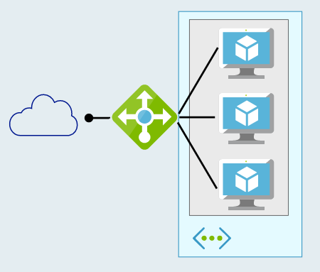
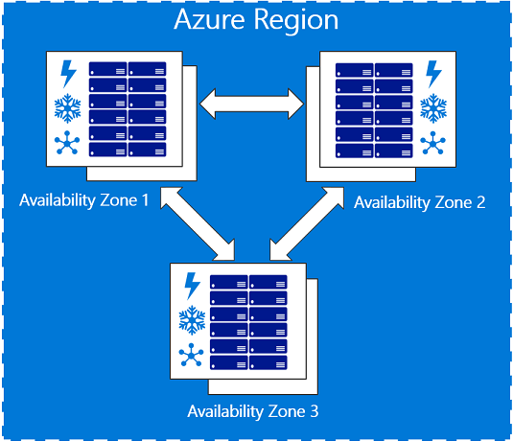
High Availability How do you implement it?
Availability Sets – 99.95% SLA
2 or more VMs in an Availability Set configured behind a Load Balancer
Availability Zones – 99.99% SLA
2 or more VMs spread across Availability Zones configured behind a Standard Load Balancer

Slide 80
ARM Template Function: copyIndex() aka looping

Slide 81
copyIndex()… Numeric Function
Add a “copy” section to a resource and reference with the copyIndex() function
"resources": [
{
"apiVersion": "2016-01-01",
"type": "Microsoft.Storage/storageAccounts",
"name": "[concat(copyIndex(),'storage', uniqueString(resourceGroup().id))]",
"location": "[resourceGroup().location]",
"sku": {
"name": "Standard_LRS"
},
"kind": "Storage",
"properties": {},
"copy": {
"name": "storagecopy",
"count": 3
}
}
https://docs.microsoft.com/en-us/azure/azure-resource-manager/resource-group-create-multiple

Slide 82
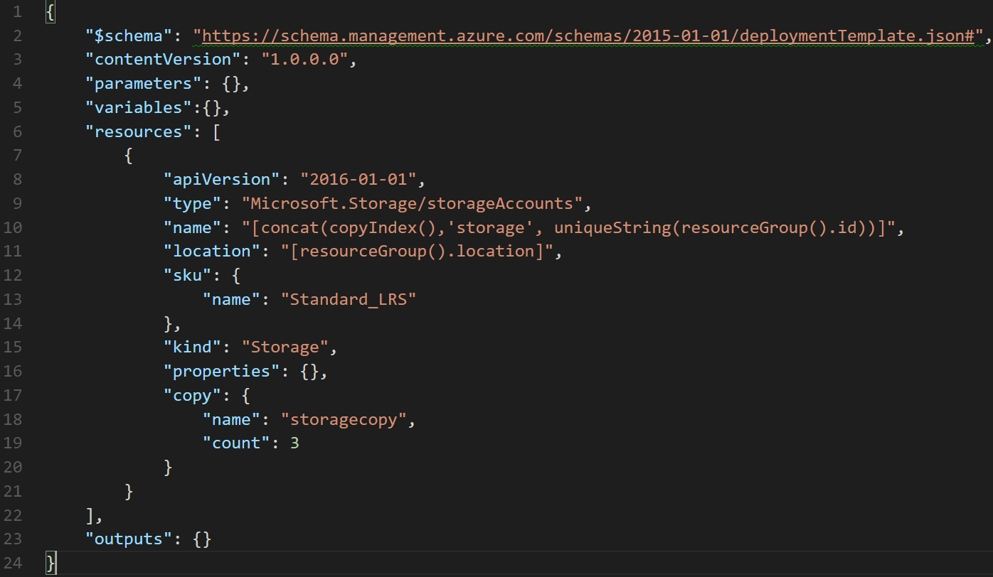

Slide 83
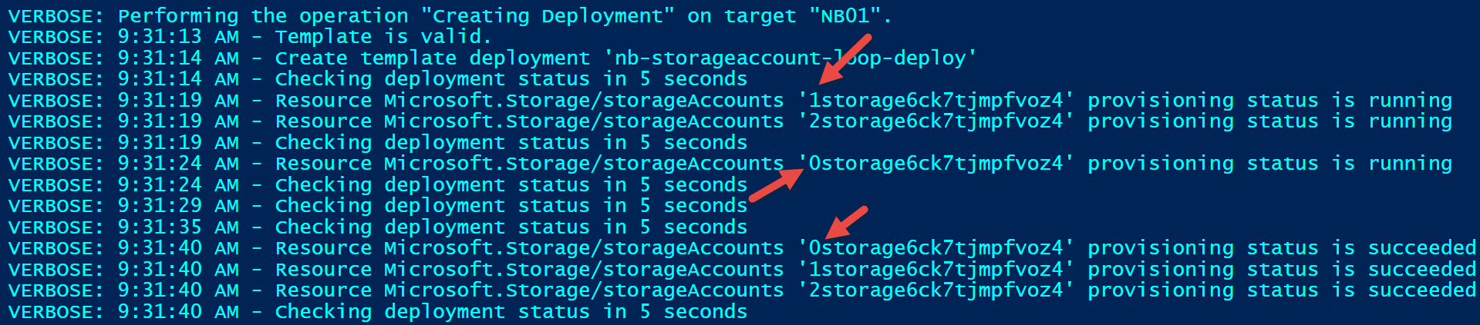
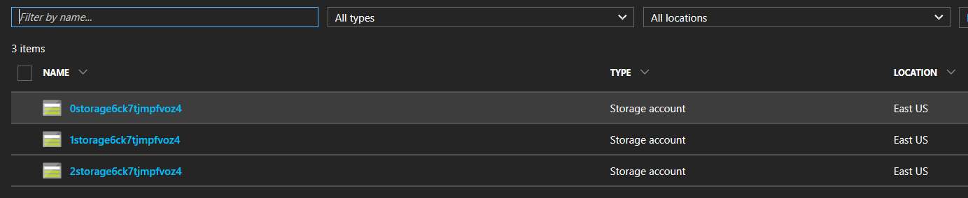
Verbose output

Slide 84
Can I create more meaningful names?
Tried:
"name": "[concat('storage-0', copyIndex(1))]", (did it work?)
Got error:
New-AzureRmResourceGroupDeployment : 9:51:45 AM - Error: Code=AccountNameInvalid; Message=storage-01 is not a valid storage account name. Storage account name must be between 3 and 24 characters in length and use numbers and lower-case letters only.
Tried:
"name": "[concat('storage0', copyIndex(1))]", (did it work?)
Got error:
New-AzureRmResourceGroupDeployment : 9:52:45 AM - Error: Code=StorageAccountAlreadyTaken; Message=The storage account named storage01 is already taken.

Slide 85
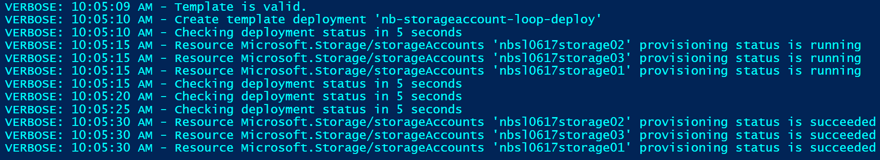
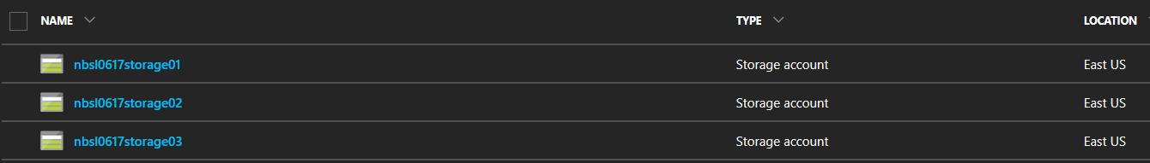
Got it working…finally
Tried:
"name": "[concat(parameters('environmentPrefix'),'storage0', copyIndex(1))]"

Slide 86
Final notes on looping with copyIndex()
You can iteratively create multiple resources of the same type
Resources are created in parallel unless the mode is set to “serial” (default is parallel…should it specified?)
You can iterate on a resource property also

Slide 87
Challenge #7 Make it highly available!
Extend ARM template to:
Add a second webserver VM
Add a public Load Balancer
Put the webservers in a backend pool
Create frontend pool enabling port 80 to website
Ensure the VMs are highly available!

Slide 88
ARM Templates: Configuring a Load Balancer

Slide 89
Challenge #9 Let in the SSH in
Extend your ARM template to configure the Load Balancer to enable SSH access to the backend virtual machines

Slide 90
ARM Templates: VM Scale Sets – a better way!

Slide 91
Challenge #10 A better way to HA
Modify the ARM template to replace the existing two virtual machines with a VM Scale Set
Configure the VMSS to have two instances
Ensure the load balancer is configured to allow you to SSH to the VMs in the scale set.

Slide 92
ARM Templates: Configuration management via custom script extension

Slide 93
Challenge #11 Configure the VM
Extend template to configure the VMs in the scale set as webservers
VM Requirements:
Linux VM (Ubuntu)
Apache website
Pull website config from: https://raw.githubusercontent.com/microsoft/WhatTheHack/master/011-InfraAsCode-ARM-DSC/Student/Resources/ARM-Challenge-10/install_apache_vmss.sh
Hint: Custom script extensions, globally unique naming context, and complex dependencies. ☺

Slide 94
ARM Advanced Feature: Linked Templates

Slide 95
Linked/Nested Templates
Useful for “separation of duties” (e.g. network team responsible for network templates, etc)
Linked templates cannot be local.
Linked templates must be ‘staged’ at an http endpoint for the Azure Resource Manager to access them.
Use a storage account or git repo for staging
You can pass parameters directly to the linked template as you would the parent template
{
"type": "Microsoft.Resources/deployments",
…
}
https://docs.microsoft.com/en-us/azure/azure-resource-manager/resource-group-template-functions-deployment

Slide 96
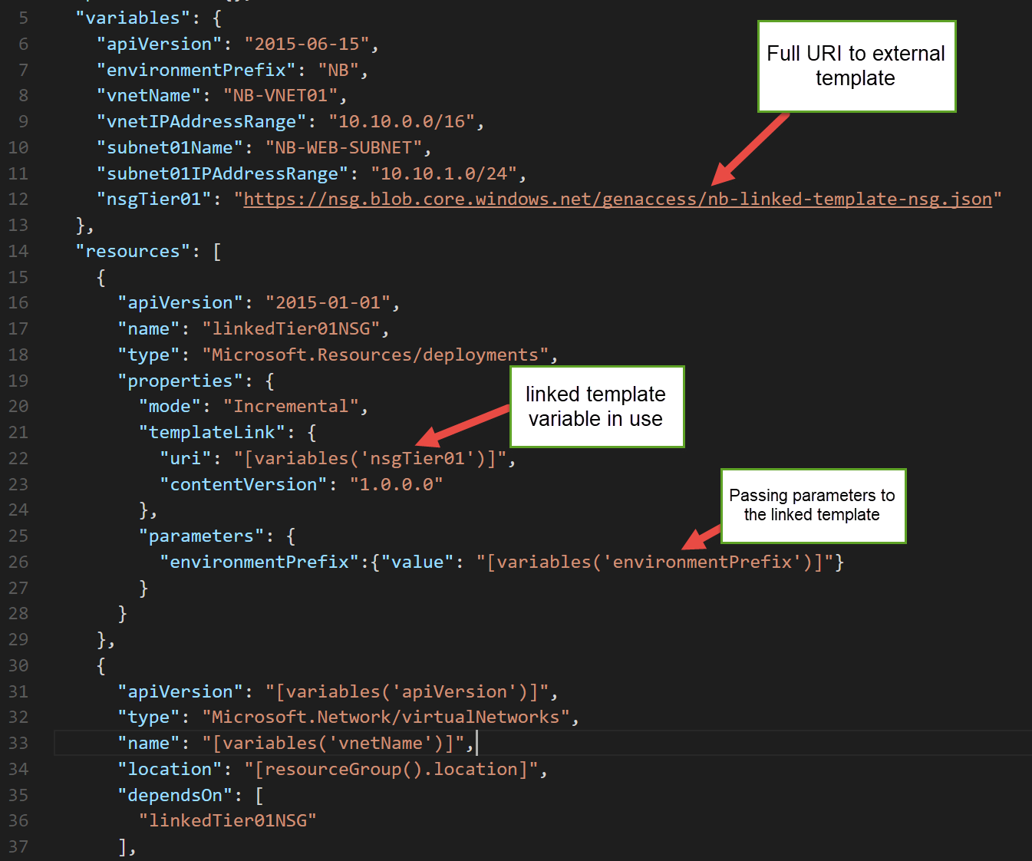
Example

Slide 97
What about linking to “private” templates?
We can do this with a SAS token!
Generate a SAS token on the container where your “private” template will be staged.
Pass the blob container URL & SAS token as parameters
Concatenate the container URL, template filename, and SAS token to construct the templateLink URI property
https://docs.microsoft.com/en-us/azure/azure-resource-manager/resource-group-linked-templates
https://docs.microsoft.com/en-us/azure/storage/storage-dotnet-shared-access-signature-part-1

Slide 98
Challenge #12 Break it up!
Pull out the VNet & NSG into their own template
Keep the VM (and its dependencies– NIC, PIP, etc) in its own template
Create a new “master” template that calls the Networking template, then the VM template

